Slide 1
DFA To RE
State elimination method

Slide 2
Procedure - State Elimination Method
Step 1 – DFA to New finite automaton GNFA
Add a new start state with epsilon transition from old start state.
Add a new final state with epsilon transition from old one.
GNFA - same as NFA
It have regular expression on transitions
Connect two states by reading a block of string
Step 2 - GNFA to RE

Slide 3
Rules of GNFA
Start state has outgoing arrow but no arrow coming
Single final state ; no outgoing arrow only incoming arrows.
Every state ( except for start and accept) have one arrow goes from every state to every other state, and also a self loop to each state.

Slide 4
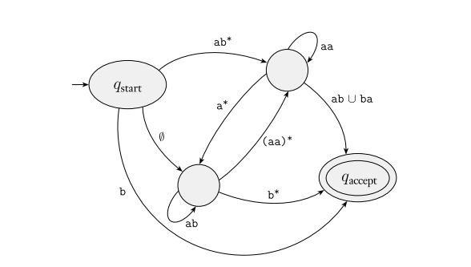
Example of GNFA

Slide 5
Basics
Self- loop does not count as Inward or Outward edge
If multiple final states are present, connect them all to the same Final state with epsilon transition
Omit dead states at the beginning
Sequence of elimination does not matter

Slide 6
Process
Need to eliminate all states that are not start or final
While elimination, we need to preserve EVERY transition
Map every inward edge of a eliminating state to every outward edge

Slide 7
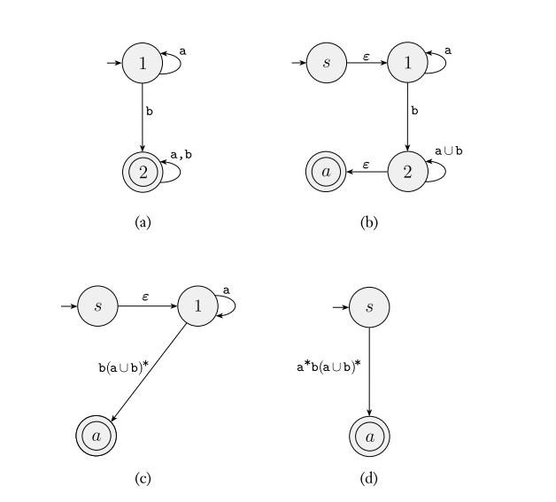

Slide 8
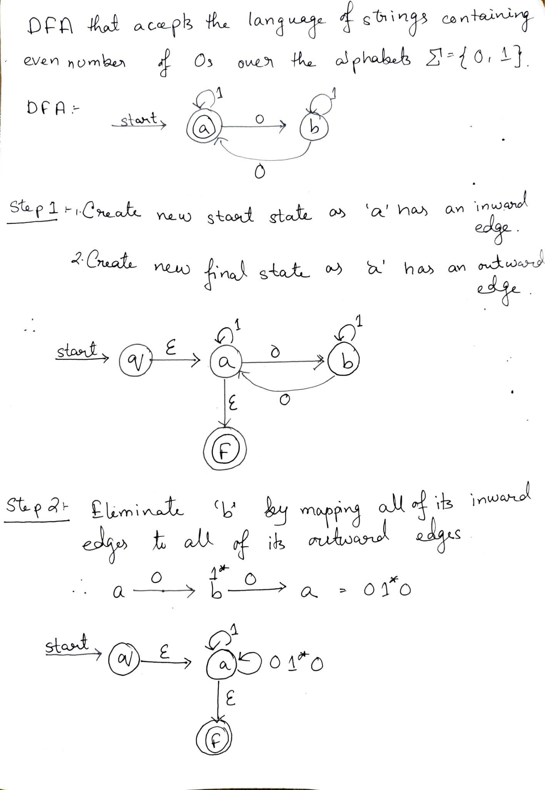

Slide 10
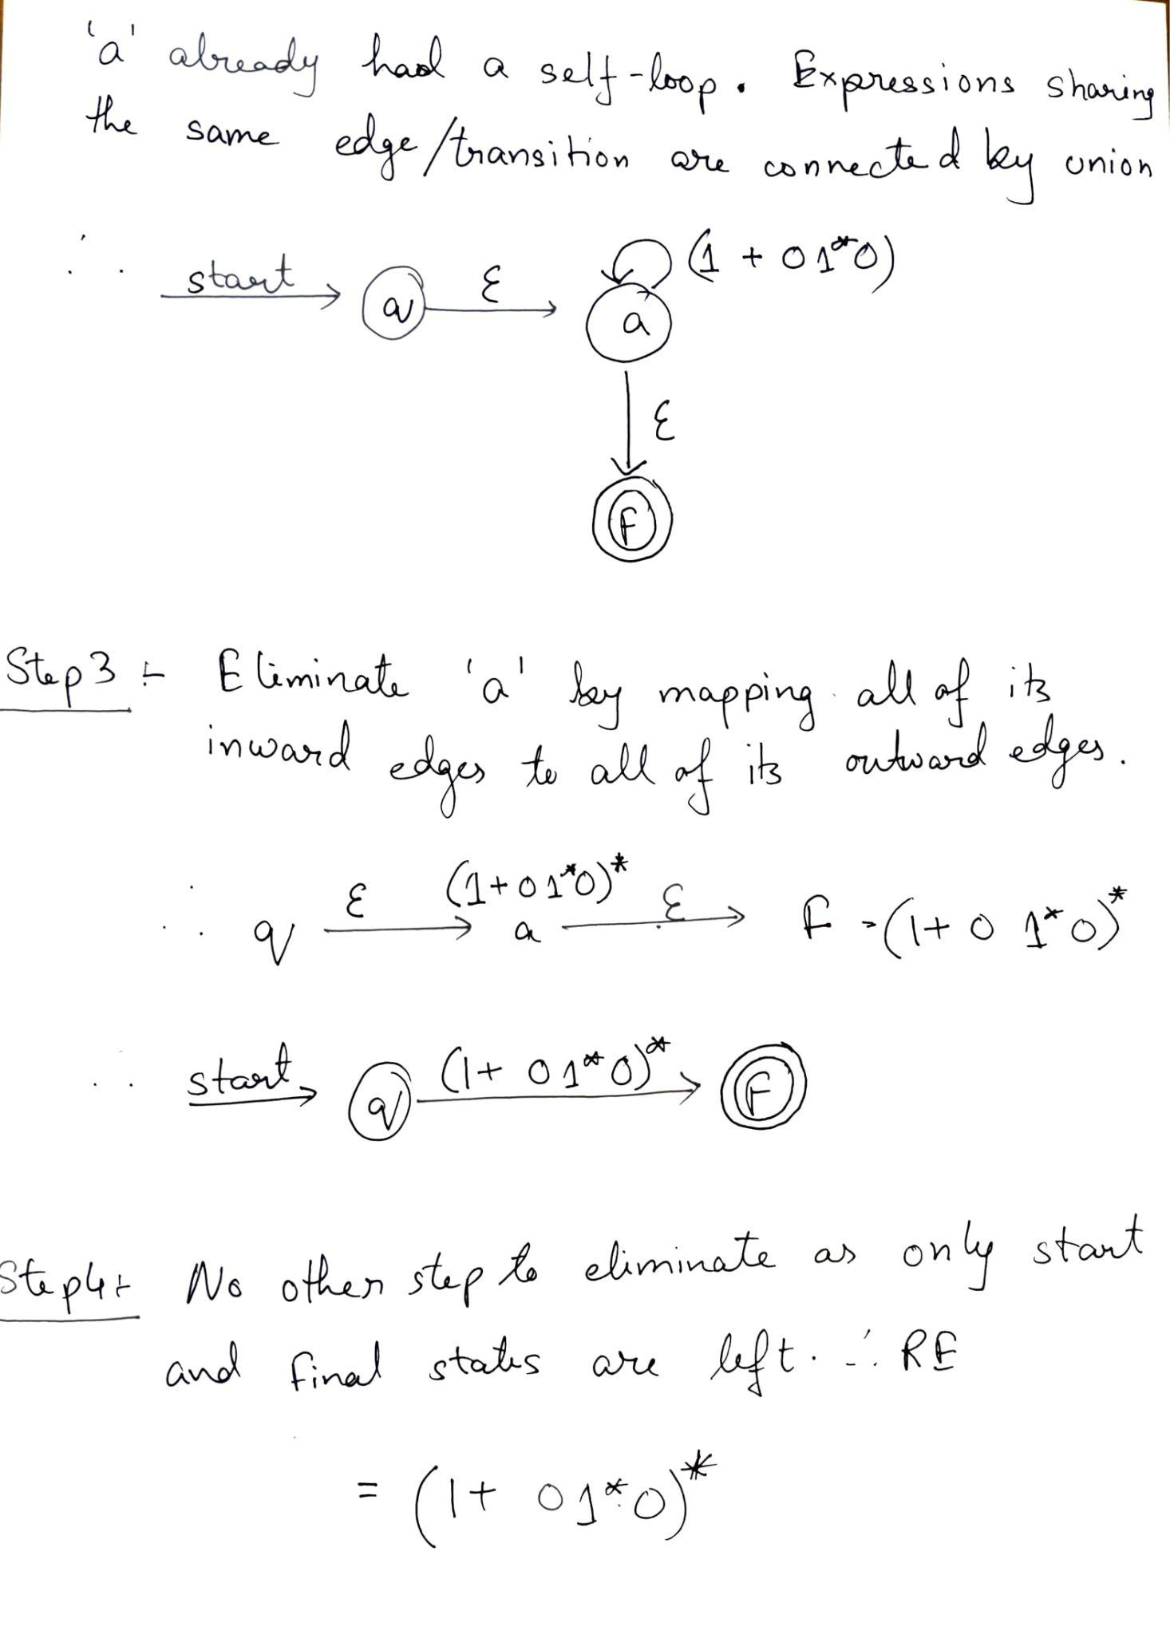

Slide 13
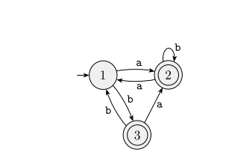

Slide 14
